Slide 1


BIRLA VISHVAKARMA MAHAVIDYALAYA
Engineering College
SCOPE
Space Collision & Orbital Proximity Evaluation System
Presented by: DHRUVANSH PANCHAL
ID: 25EC417
Course: 204ES OBJECT ORIENTED PROGRAMMING
Department: ECE

Slide 2
Introduction
  Earth’s orbit contains numerous satellites(active and deactive), space debris and rocket bodies.
  Objects in low Earth orbit travel at about 7 to 8 km/s. A collision at this speed can destroy a satellite, even if the other object is only a small fragment.
  Increasing orbital congestion raises the risk of close approaches and potential collisions.
  Monitoring the positions and movements of orbital objects is essential for space safety.
  SCOPE (Space Collision & Orbital Proximity Evaluation System) is a C++-based project that simulates orbital objects, detects close approaches, and evaluates potential collision risks.
  The project applies Object-Oriented Programming (OOP) concepts to a real-world space technology problem.
SCOPE | 204ES Object Oriented Programming
2

Slide 3



Problem Statement
Crowded orbits
THE PROBLEM
Satellites, rocket stages and debris share the same space.
The increasing number of satellites and space debris in Earth’s orbit raises the risk of close approaches and potential collisions. Continuous monitoring is essential to identify hazardous encounters, and early risk assessment can help protect valuable space assets.
Extreme speeds
Objects move at about 7 to 8 km/s, so even small fragments are dangerous.
Early warning needed
Spotting close approaches early gives time to respond.
Our approach: Model every orbiting object as a class, simulate their motion, measure separation, and classify the risk.
SCOPE | 204ES Object Oriented Programming
3

Slide 4
Objectives
1
2
3
Model objects with OOP
Simulate orbits
Detect close approaches
Abstract class, inheritance and polymorphism for satellites, debris and rocket bodies.
Circular-orbit equations give each object’s position over time.
Find minimum distance, time and relative velocity for every pair.
4
5
6
Classify risk
Store and report
Handle errors safely
Transparent scoring into LOW, MODERATE, HIGH or CRITICAL.
Save and load data files and generate risk reports.
Exceptions and input checks so the program never crashes.
SCOPE | 204ES Object Oriented Programming
4

Slide 5








Main Features of the Application
Add objects
View details
Simulate orbits
Close approaches
Satellites, debris and rocket bodies
Orbit, speed, period and mass
Positions at chosen times
Minimum distance, time and relative velocity
Risk levels
Risk reports
Save and load
Safe input
LOW, MODERATE, HIGH or CRITICAL
Detailed report saved to a file
Text files keep data between runs
Errors are handled without crashing
SCOPE | 204ES Object Oriented Programming
6

Slide 6
Modules Used: System Architecture
ConsoleUI
menu and user input
Simulation
owns objects, finds approaches
RiskAnalyzer
scores and classifies
DataManager
save and load files
ReportGenerator
builds the report
OBJECT HIERARCHY
SUPPORTING CLASSES
OrbitalObject
abstract base class
Orbit
circular-orbit maths
Vector2D
position and velocity
Conjunction
result for a pair
Satellite
SpaceDebris
RocketBody
Every object has an Orbit; Simulation owns all objects through base-class pointers.
SCOPE | 204ES Object Oriented Programming
7

Slide 7
OOP Concepts Used
Concept | Where it is used in SCOPE
Abstraction | OrbitalObject has pure virtual functions and cannot be created directly
Inheritance | Satellite, SpaceDebris and RocketBody extend OrbitalObject
Polymorphism | Virtual calls through base pointers in Simulation, RiskAnalyzer and DataManager
Encapsulation | Private data members; Orbit rejects invalid altitude in its constructor
Overloading | getDistance() has two versions; Vector2D overloads + - * and <<
Templates | readNumber<T>() reads int or double safely
STL | vector, map, unique_ptr and sort
Exceptions | Custom ScopeException hierarchy handled in the menu loop
File handling | ifstream and ofstream in DataManager and ReportGenerator
SCOPE | 204ES Object Oriented Programming
8

Slide 8
How SCOPE Works
1
2
3
4
5
6
7
Input
Create
Simulate
Detect
Evaluate
Report
Save
Add or load objects
Build objects with orbits
Positions over time
Closest approach per pair
Risk score and level
Summary and details
Data and report files
Closest-approach detection
Scan 120 minutes in 1-second steps, find the smallest separation, refine it, then record the time and the relative velocity.
SCOPE | 204ES Object Oriented Programming
9

Slide 9
Outcomes
Object pair | Min distance | Time | Relative velocity | Score | Risk level
SAT-002 / DEB-002 | 0.60 km | 13.70 min | 15.02 km/s | 94 | CRITICAL
SAT-001 / DEB-001 | 1.82 km | 24.94 min | 15.18 km/s | 79 | HIGH
SAT-003 / DEB-003 | 12.00 km | 26.61 min | 14.90 km/s | 49 | MODERATE
Other 18 pairs | above 25 km | - | - | 0 | LOW
21
3
14 / 14
object pairs analysed
close approaches found
test cases passed
SCOPE | 204ES Object Oriented Programming
12

Slide 10
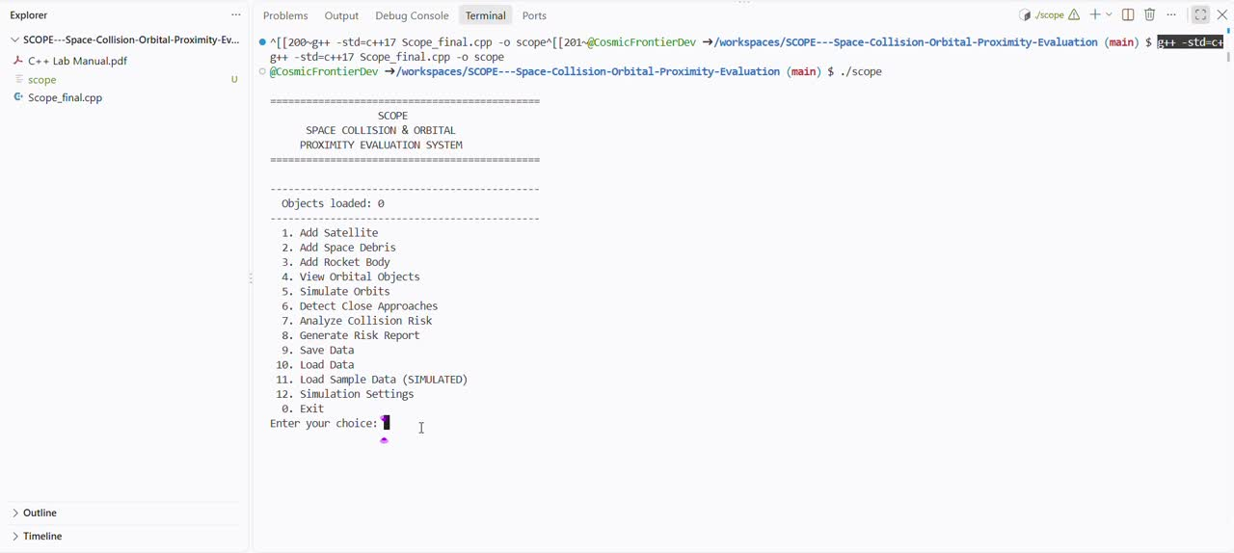
Working Video
SCOPE | 204ES Object Oriented Programming
13

Slide 11


Limitations and Future Scope
Limitations
Future Scope
  2D circular orbits only
  Objects are not affected by air resistance or other disturbing forces.
  Simulated data, not real tracking
  No uncertainty or collision probability
  Objects do not change their paths or directions intentionally.
  3D elliptical orbits
  Uses real satellite orbital data and a model to predict their positions.
  Probability of collision
  Plans changes in an object's path to prevent collisions.
  Graphical orbit display
SCOPE | 204ES Object Oriented Programming
14

Slide 12
References
  Bjarne Stroustrup, The C++ Programming Language, Addison-Wesley
  E. Balagurusamy, Object-Oriented Programming with C++, McGraw-Hill
  cppreference.com: C++ standard library documentation
  H. D. Curtis, Orbital Mechanics for Engineering Students, Elsevier
  NASA Orbital Debris Program Office and ESA Space Debris Office: public overview pages (background only)
  Project source code: github.com/CosmicFrontierDev/SCOPE-Space-Collision-Orbital-Proximity-Evaluation
SCOPE | 204ES Object Oriented Programming
15

Slide 13
Thank You
SCOPE applies Object Oriented Programming to a space-safety problem in a tested, modular C++ program.
Questions?

